Slide 1
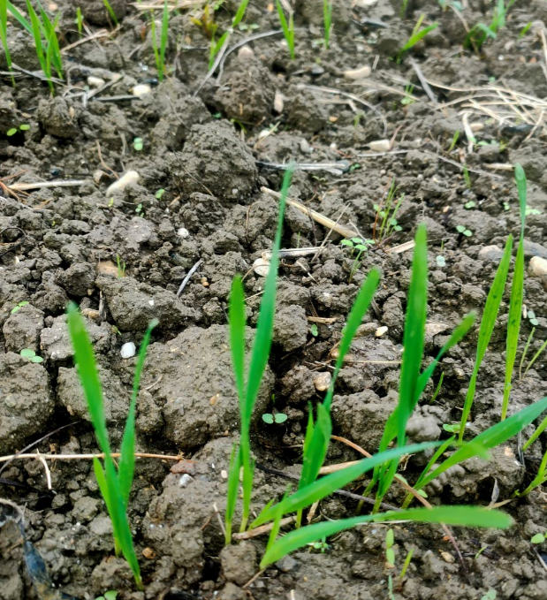
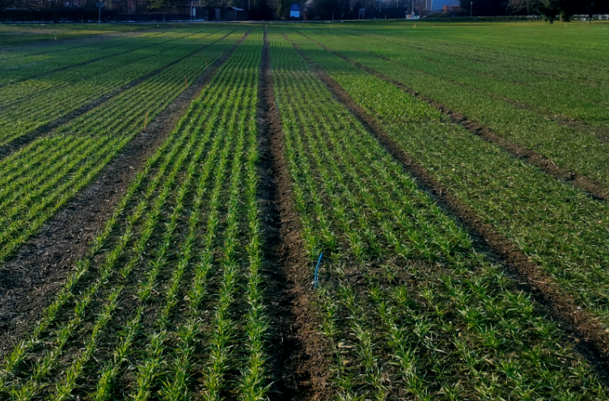
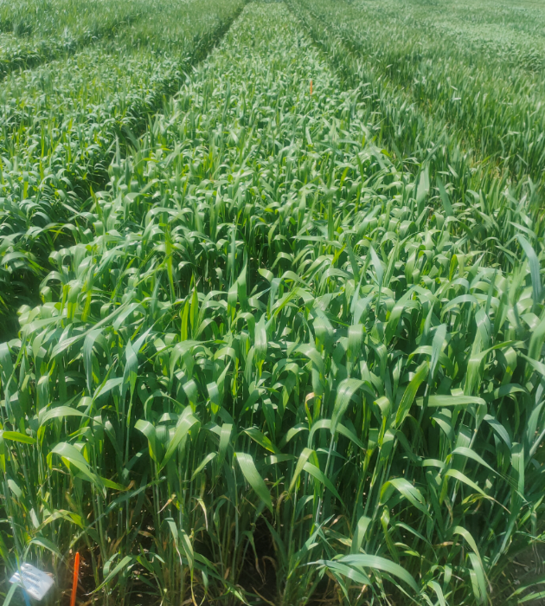
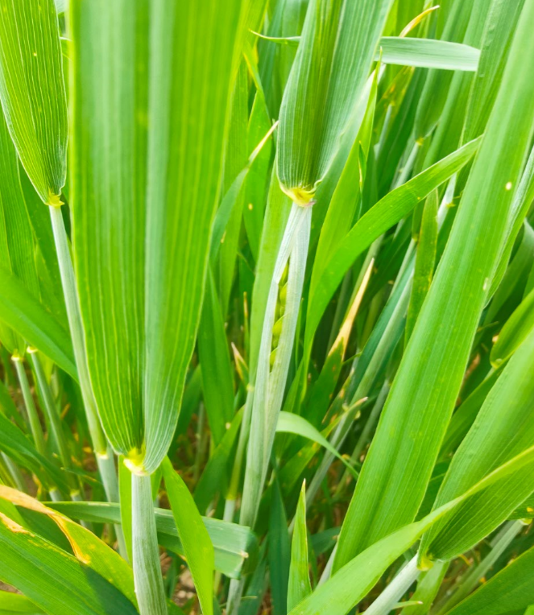
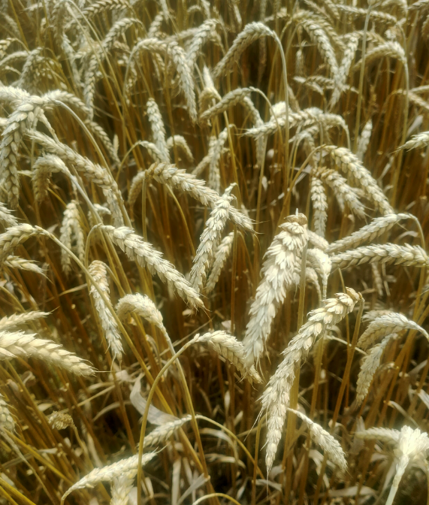
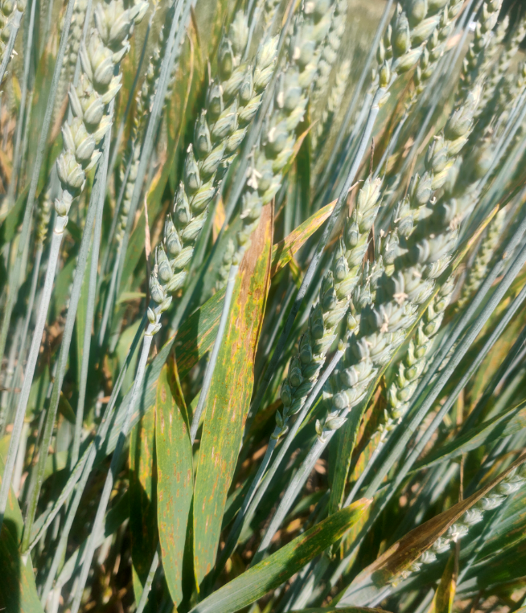
Module 5- Concept for a final CAS project
Nicolas Vuille-dit-Bille

Slide 2
SMART objectives
Predict winter wheat nitrogen (N) status in different environments and at different crop stages using hyperspectral indicators (spectral vegetation indices) in order to optimize N fertilization strategy (economic and environmental cost), crop yield and grain quality (recommendation to farmers).
The prediction should perform accurately at 3 hierarchical levels:
1) Site (soil N status and climatic condition)
e.g. Site 1 needs more N than Site 2
2) Field (spatial heterogeneity)
e.g. One part of the field needs more N than the other part
3) Wheat variety (N use efficiency (NUE))
e.g. This specific variety needs more N because it as lower NUE
At the end, a selection of specific spectral band should allow the model to predict accurate amount of N to apply at specific environment, field and variety level in order to optimize fertilization application (maximum grain yield for minimum N loss)

Slide 3
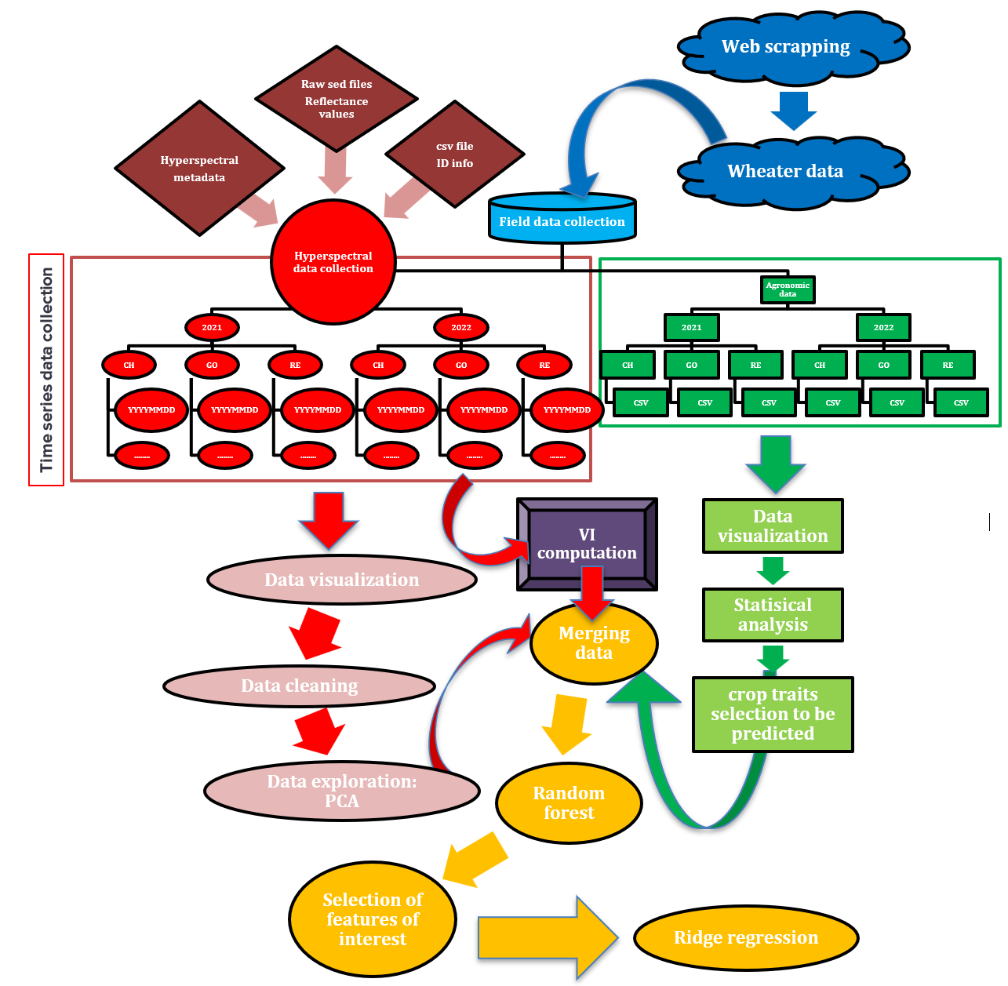
Planned data
5 winter wheat varieties
2 years: 2021 to 2022
3 sites: Changins, Goumoens and Reckenholz
3 main treatments: none, reduced and conventional
Measurement to estimate varieties performance:
Grain yield
Straw yield
Grain protein
Other physiological parameters (harvest index, leaf area index, chlorophyll content, canopy cover…)
Hyperspectral data

Slide 4
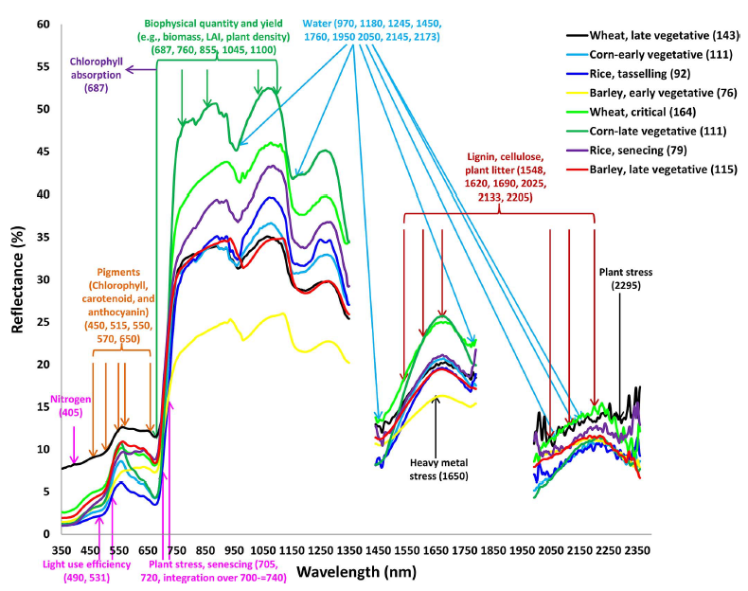
Data quality
FIELD DATA
THEORY
Thenkabail, P. S., Mariotto, I., Gumma, M. K., Middleton, E. M., Landis, D. R., & Huemmrich, K. F. (2013). Selection of hyperspectral narrowbands (HNBs) and composition of hyperspectral twoband vegetation indices (HVIs) for biophysical characterization and discrimination of crop types using field reflectance and Hyperion/EO-1 data. IEEE Journal of Selected Topics in Applied Earth Observations and Remote Sensing, 6(2), 427‑439. https://doi.org/10.1109/JSTARS.2013.2252601
Remove bands with aberrant values : <0 or >1
Remove bands with 0 value

Slide 5
Methods
Unsupervised learning
Data exploration and features selection with PCA
Supervised learning
Random forest
Partial least square (PLS)
Not covered in the course
Best approach to deal with hyperspectral data
Performs dimensionality reduction and handles multicollinearity

Slide 6
Performance metrics (PLS)
Root Mean Squared Error (RMSE)
Model error with same unit as the response variable
Compare Mean Absolute Error (MAE) and Mean Squared Error (MSE)
MAE: less sensitive to ouliers
R² (Coefficient of Determination) or adjusted R²
Proportion of variance in the response variable predictable from the predictors
Adjusted R² penalizes the inclusion of irrelevant predictors (more realistic in this context
Cross-Validation Metrics:
Q²: similar to R² but on unseen data
Predicted Residual Sum of Squares (PRESS):
Sum of squared prediction errors from cross-validation
Lower PRESS indicates better predictive performance

Slide 7
Other performance metrics (random forest)
Mean Absolute Percentage Error (MAPE):
Expresses prediction errors as a percentage of actual values
Prediction Error Variance (Uncertainty):
Identify regions where predictions are less certain by comparing variance in predictions across trees in the forest
Out-of-Bag (OOB) Error:
Cross-validation-like estimate of prediction error computed during model training (out of bootstrap sample)
Cross-Validation Metrics:
k-fold cross-validation to estimate performance metrics like RMSE, MSE, or R² on unseen data (model generalization estimate)

Slide 8

Thank you for your attention
Nicolas Vuille-dit-Bille nicolas.vuille-dit-bille@agroscope.admin.ch
Agroscope good food, healthy environment
www.agroscope.admin.ch

